Slide 1
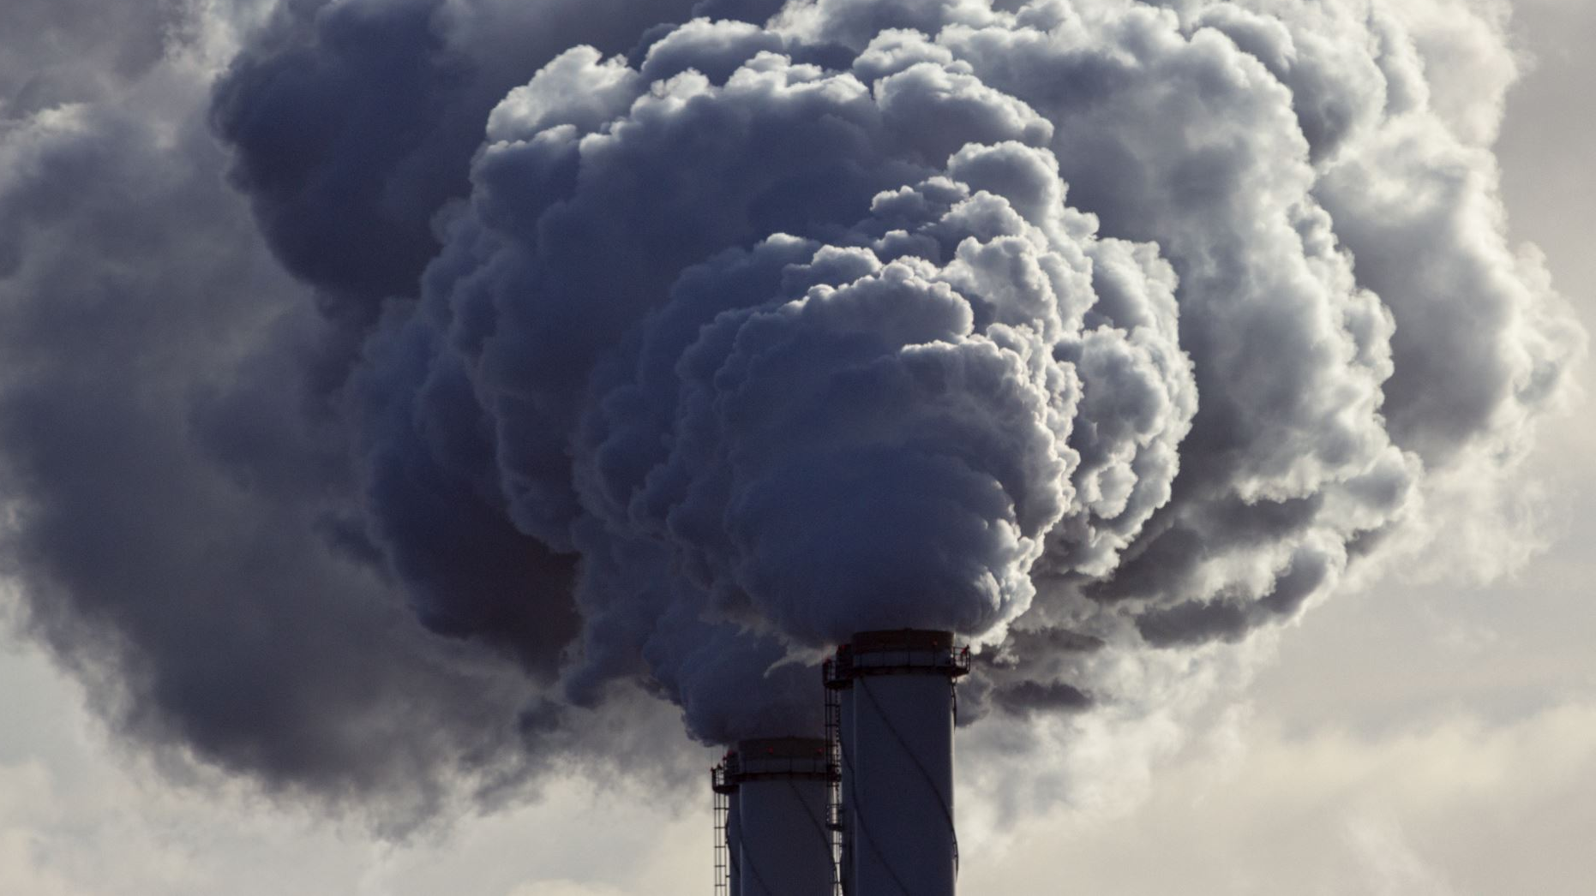
Global Air Pollution

Slide 2

Pollution has significant impacts on human health, the environment, and even on how some of the Earth's systems, such as the climate, are functioning.
Pollution touches all parts of the planet. It is affecting our health through the food we eat, the water we drink, and the air we breathe.
Globally, 93 % of all children breathe air that contains higher concentrations of pollutants than the World Health Organization (WHO) considers safe for human health.
Air pollution is responsible for more deaths than many other risk factors, including malnutrition, alcohol use, and physical inactivity.

Slide 3
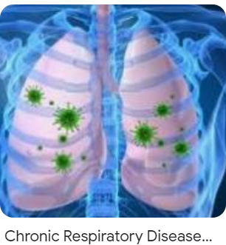
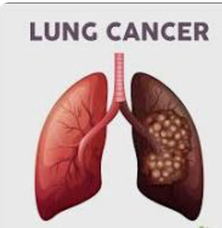
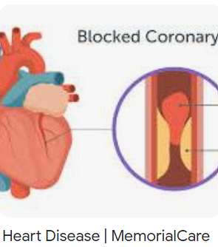
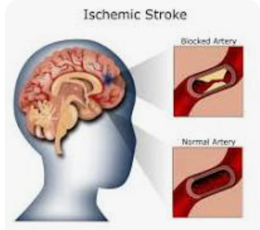
RISK FACTORS

Slide 4

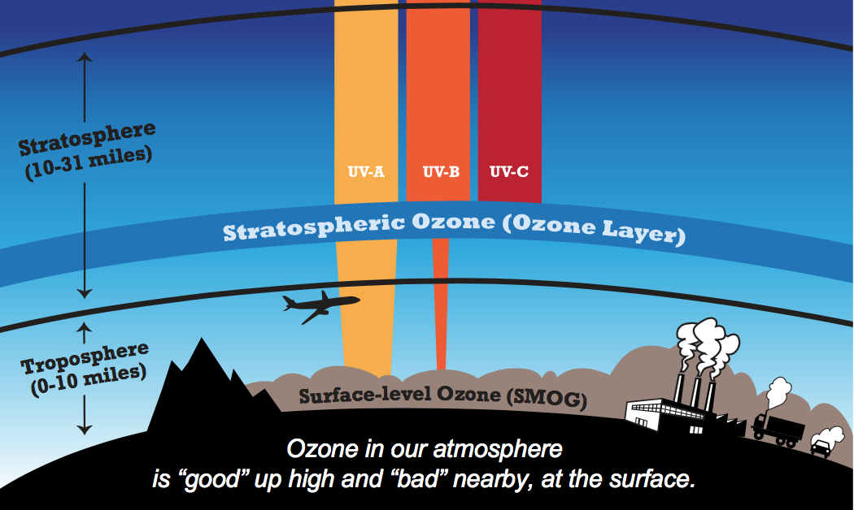

Slide 5

Objective :
Analyze and compare air quality data across major cities around the world.
To identify pollution trends and highlight areas with critical air quality issues.

Slide 6
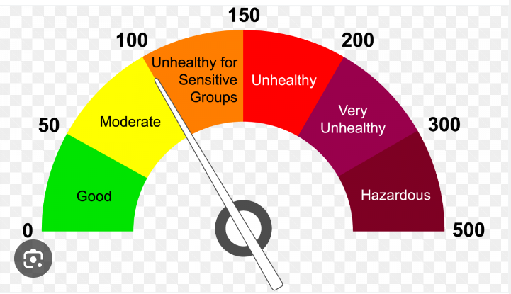
AQI Air Quality Index - a yardstick that runs from 0 to 500. The higher the AQI value, the greater the level of air pollution and the greater the health concern.

Slide 7
Carbon Monoxide - CO Nitrogen Dioxide – NO2 Ozone Particle Pollution - PM 2.5
POLLUTANTS

Slide 8
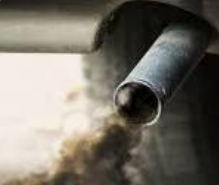
Carbon Monoxide - CO
The greatest sources of CO to outdoor air are cars, trucks, and other vehicles or machinery that burn fossil fuels.
A variety of items in your home such as unvented kerosene and gas space heaters, leaking chimneys and furnaces, and gas stoves also release CO and can affect air quality indoors.

Slide 9
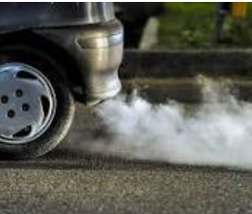
Nitrogen Dioxide – NO2
Most often this happens in the combustion process of oil or coal, but more commonly in urban areas.
Nitrogen oxides are released through the combustion of cars and other road vehicles.

Slide 10

Ozone
Ground-level ozone forms when nitrogen oxides and volatile organic compounds react with each other in sunlight and hot temperatures.
This pollution comes from vehicles, industry, and other sources and contributes to smog formation.

Slide 11
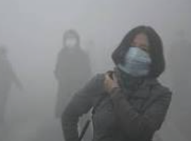
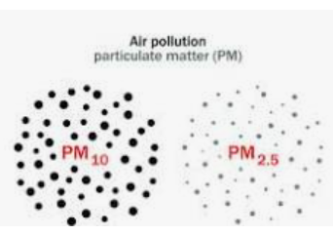
Particle Pollution - (PM 2.5)
Particle pollution — also called particulate matter (PM) — is made up of particles (tiny pieces) of solids or liquids that are in the air.
These particles may include Dust. Dirt. Soot.

Slide 12
THE ANALYSIS

Slide 13

1) Highest AQI Country and City 2) Lowest AQI Country and City 3) Highest CO_AQI for the City 4) Highest Ozone_AQI for the City 5) Highest NO2_AQI for City

Slide 14

In a nutshell, every kind of pollution leaves a huge negative impact on our environment, human lives, animals, etc. We, as responsible citizens, must take steps towards a better tomorrow. We must join hands to take various initiatives and fight against this problem.
The next slide will show some ways we can help.

Slide 15
The DATASET
1. AQI – Air Quality Index
2. Pollutants
References:-
https://www.kaggle.com/datasets/hasibalmuzdadid/global-air-pollution-dataset/data
https://www.pranaair.com/us/blog/10-ways-to-reduce-air-pollution/

Slide 16






THE TOOLS USED :

Slide 17





Slide 18

Rachel B, Ved P, Teresita L, Eirynell R
Take Care of Your Health

